Slide 1
Integrated Neonatal Care Unit: Capturing Neonatal
Journey in an Intelligent Data Way

Slide 2
Introduction
About 15 million babies are born preterm each year.
Orders of severity and complications in preterm birth are usually inversely associated with gestational age that has 3 categories: extremely preterm (<28 weeks), very preterm (28 to <32 weeks) and moderate to late preterm (32 to <37 weeks). Neonates born in <32 weeks of gestation are grouped under B critical care group^ and need to be maintained in intensive care units specialized in the care of ill or premature newborn infants, termed as NICU. Based on the criticality of the newborns, there are 3 defined levels of NICU: Level I stabilize sick newborns and low-birth weight babies, which do not require intensive care. Level II are equipped to support sick newborns other than those who need ventilator support and surgical care. The level III units are the neonatal intensive care units
Lots of data is gathered in a NICU but it’s hard to track it all.
Lots of specialised training is needed to help support NICUs and lost of rapidly changing tasks that need to be filled

Slide 3
Goal
For achieving these goals, we are presenting in this paper, Cloud, IoT and Data Analytics based software solution, iNICU (integrated Neonatal Intensive Care Unit). iNICU is a comprehensive integrated platform especially designed to address all the current issues of NICU such as tedious workflow,integration of the data generated by multiple devices at one place, automatic drug/nutrition calculator, auto-discharge summary, complete assessment sheets for all critical biological systems of newborns, digitized prescription, lab-oratory reports, nursing notes, prenatal data, notifications/ alerts to the doctor, parent engagement, predictive analytics and NICU management (Fig. 1). Our vision is to provide complete automation with analytics to benchmark for the quality care of the newborns. iNICU allows concurrent real time access of multiple infants to clinical experts and thus, improves the care time. Key long term benefits of our solution are care time improvement, filling skill gap, remote monitoring of rural regions by experts, early identification of disease, and reduction in neonatal mortality.

Slide 4
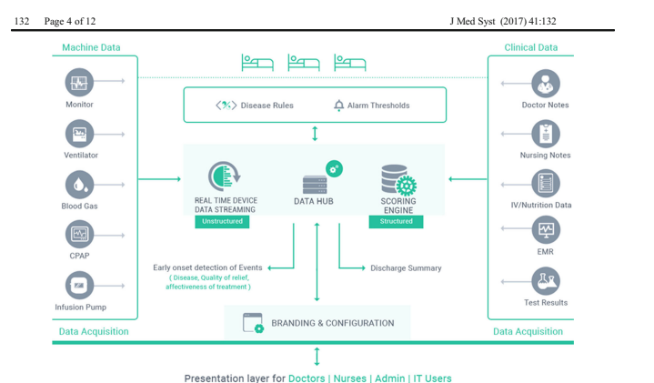
Architecture

Slide 5
Machine data integration
Broken into 2 separate parts
MDI server
MDI Server layer is implemented using open source Apache Kafka. MDI Server subscribes to real time streams of data coming from various MDI client implementations. It uses Apache Cassandra to store unstructured data. MDI Server piece also integrated with Lab Information Management System via ASTM protocol (JAVA ASTM API).
MDI Client
allowing interaction of iNICU system with various devices. These devices provide data over WAN, Network or Serial cable.

Slide 6
Clinical interface
The doctor/nurse interface is built using service oriented architecture. The server part is implemented using Java 1.8 language leveraging Spring Boot framework. User Interface layer is built using responsive AngularJS (JavaScript Framework) and HTML5. This allows User Interface layer to be responsive and it can run seamlessly on Tablet, Laptop and Mobile devices. JSON based REST API integration connects AngularJS and Spring layers. Patient data is accessed either from Hospital Information System as ADT (Admission Discharge Transfer) events through HL7 Integration or manually entered by the Hospital administration. Clinical data stored in PostgreSQL and Hibernate allows access of database from Java business layer. Various Neonatal calculators are coded using Drools rule engine and stored as metadata. Solution is hosted on IBM Softlayer based cloud infrastructure. Growth charts are implemented using highcharts and JavaScript. Cloud component allows only HTTPS based communication protected by 256-bit encryption with web interface.

Slide 7
Data analytics engine
Clinical data is stored in PostgreSQL and waveform/machine data is stored in Apache Cassandra. Normalized data was fetched from both unstructured and structured data stores. Disease based neonatal score help to categorize infant into different diseases. Incoming facts (urine output, Respiratory Rate, Heart Rate, SpO2 etc.) of child act as input to Clinical Rules and matching rules inferences are executed. These inferences generate alarm and notification which are send via SMS/Google Cloud Messaging and Apple Push Notification Service to doctor, nurses and patients (specific one).

Slide 8
Highlights of iNICU system
iNICU automates the entire workflow of NICU from the admission of newborn till its discharge. It caters the entire responsibility of doctors, nurses and paramedical staff and also provides analytics for the child healthcare and hospital management system. iNICU system can be broadly classified into four important sections: 1) Digitization of clinical investigation, 2) Clinical care time improvement by auto-calculators, 3) Neonatal scores based real-time alarms, and 4) Deep learning based analytical model for early prediction of disease onset.

Slide 9
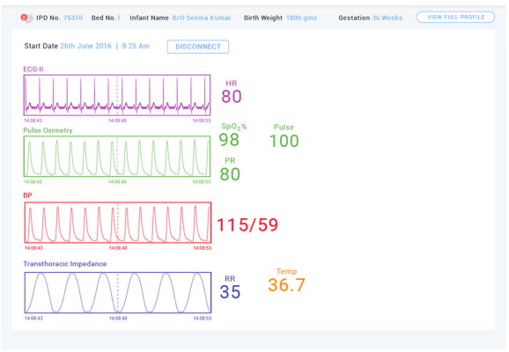
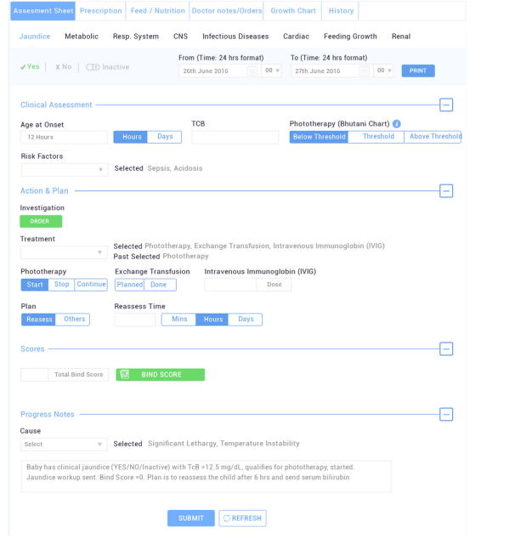
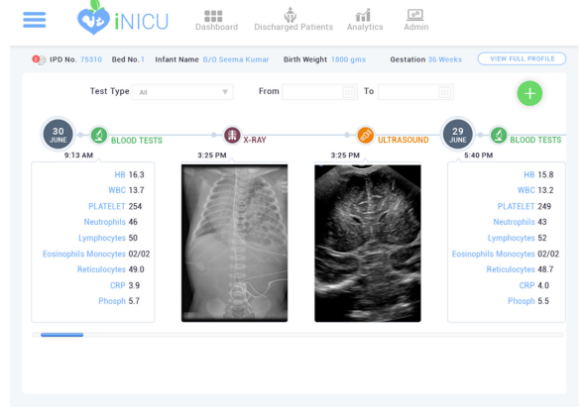
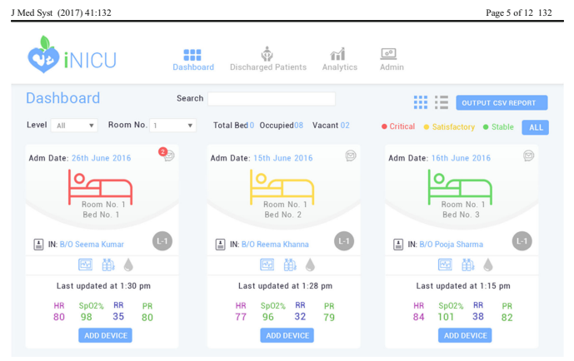
Digitization of NICU workflow

Slide 10
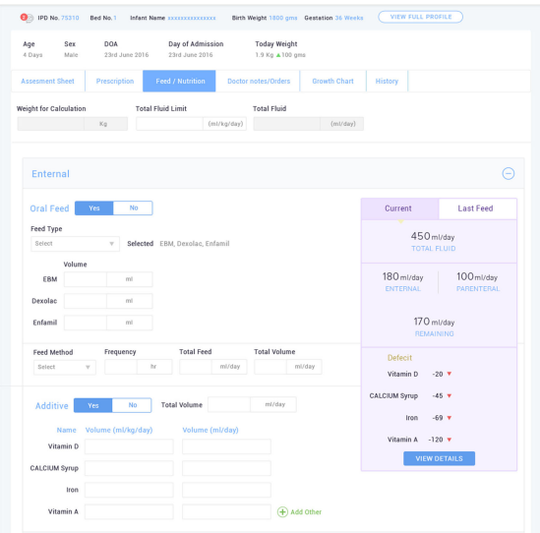
Clinical care time improvement: Neonatal calculators
iNICU improves clinical care time by integrating several key calculators used in the neonatal care such as, gestation calculator, dose Calculator, nutrition calculator (EN and PN), calorie calculator, dextrose calculator. Total fluids requirements vary as per the gestational age and weight of the baby

Slide 11
Neonatal scores
Neonatal Scores are statistical indexes, which can reproducibly predict mortality and specific morbidities in the neonates. These scores are well accepted among major clinical communities for the risk assessment of newborn at NICU. iNICU has integrated nine neonatal scores to support the clinicians in physiological system assessment of each of the newborn.
For example; APGAR and BALLARD are used to predict the overall status of the physical and neuromuscular activities of the infant, respectively.

Slide 12
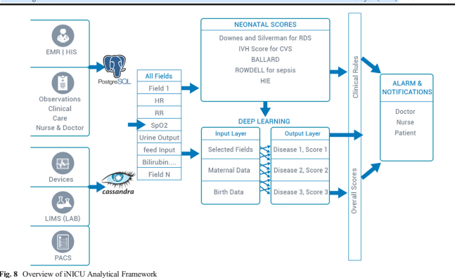
Analytics for disease onset prediction (Deep learning
neural network)
Multiple medical fields have been clustered into two buckets of structured (EMR/HIS and observatory fields from Doctor’s & Nursing notes) and unstructured data (medical devices integration, LIMS and PACS)
From the data hub, all these fields are captured to compute existing consensus based neonatal scores to build clinical rules engine. Predicted diseases generate alerts for the hospital staff.

Slide 13
Limitations & challenges
iNICU is designed to automate NICU workflow with user friendly design and features for doctors and nurses.
To handle issues related to power outage and network connectivity, iNICU system deployment in rural areas allows offline-working capability. Server residing in local network is regularly synchronize with cloud infrastructure based on availability of services.
System generates reminders based on defined clinical guidelines i.e. BPD classification based on 28 days of ventilator usage for preterm babies at 36 weeks. However, physiological data based alarms (i.e. apnea, bradycardia and desaturation) need to be validated by nurses/doctors as a check for any device artifact. To ensure data completeness or avoid incorrect entry, we have various validations such as; pop-up reminders for mandatory fields, mostly auto-filled data from lab/device if possible, only allowable ranges in drop down.

